Slide 1
More on Bible Prophecy
The Miracle of Israel
(and God’s Covenant to them)

Slide 2

The rebirth of Israel was a miracle!

Slide 3

Some Covenants in the Bible
Some are conditional (God does His part and we do ours)
Some are NOT conditional (God does His part regardless of what we do

Slide 4
Some examples of Bible Covenants
With Adam before and after the Fall (Genesis 2:16; 3:17-19))
With Noah (Genesis 9:1-17)
With Abraham (Genesis 12:1-3)
With David (2 Samuel 7:4-16)
With the nation of Israel
  Before the promised land (Deuteronomy 28)
  On their way to the promised land ((Exodus 19:5-6)
  After entering the promised land (Joshua 24:15)
A brand new Covenant promised to Israel (Jeremiah 31:31-35)

Slide 5
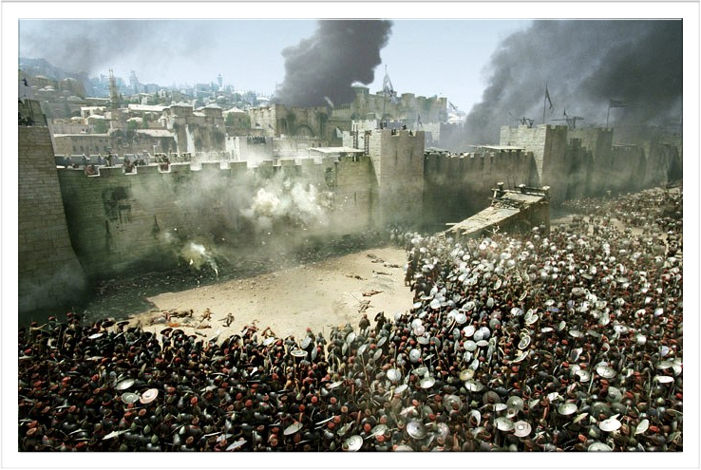
A word on Israel
No other nation in history has been destroyed and scattered and later come together and restore their language and customs

Slide 6
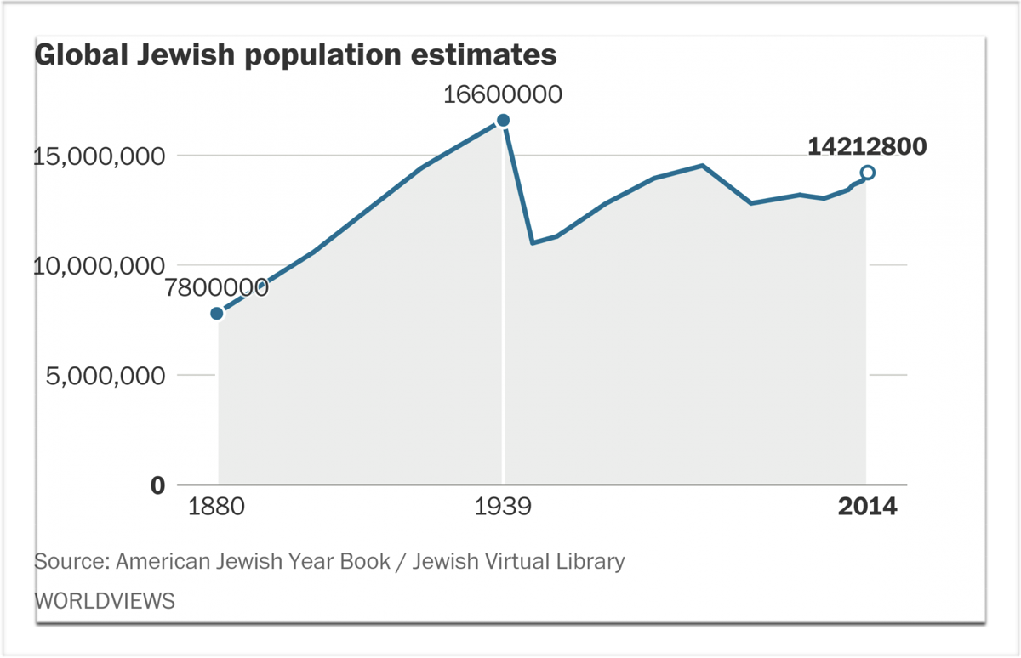
The scattered people will be few in number
(Deuteronomy 4:27)
There are now only 14 million Jews in a world of 7 billion!

Slide 7
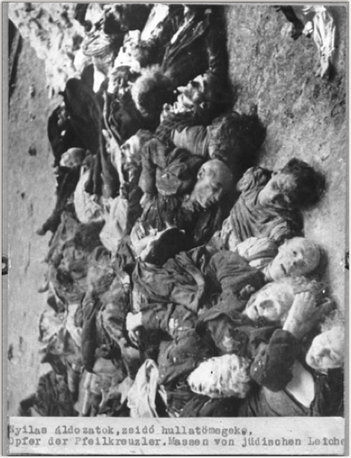
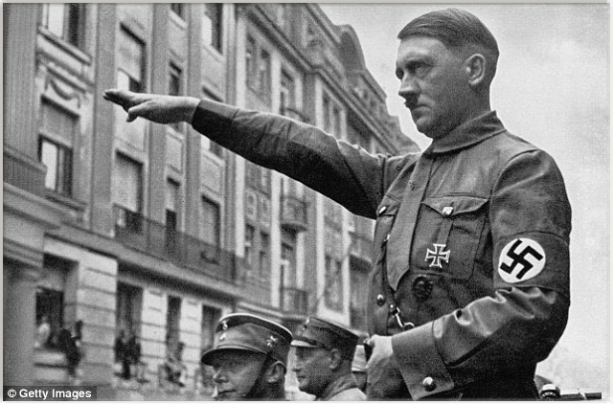
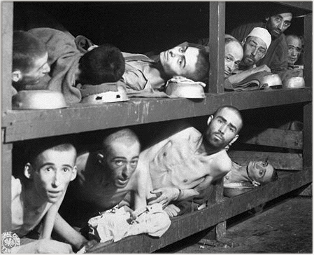
They will be persecuted
(Leviticus 26:3)

Slide 8

A Holocaust of unimaginable evil

Slide 9
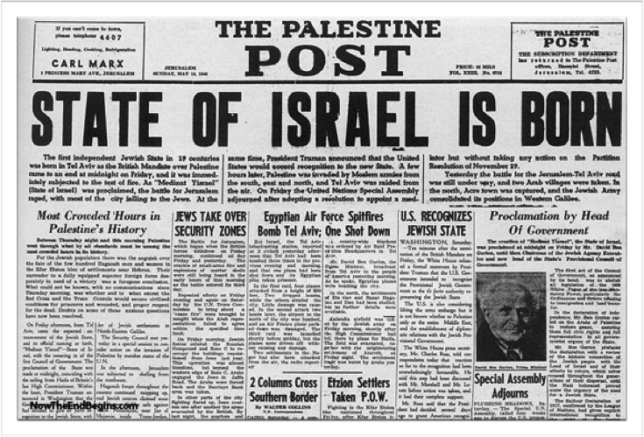
They will return to the land
(Jeremiah 29:14, 31:7-9; Ezekiel 37:12; Zechariah 8:8)

Slide 10
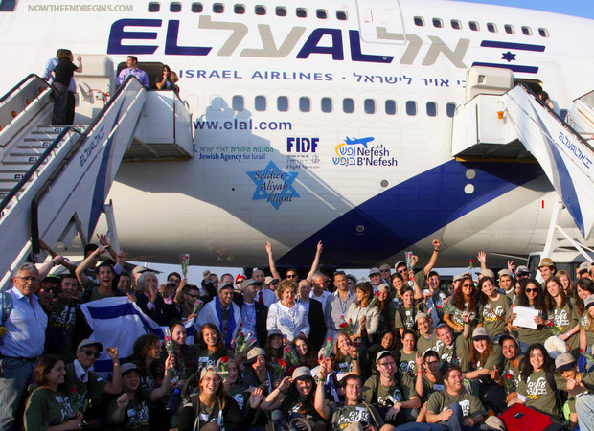

Slide 11
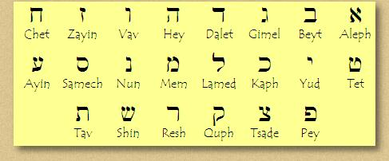
The language and culture will be restored!
(Zephaniah 3:9)

Slide 12
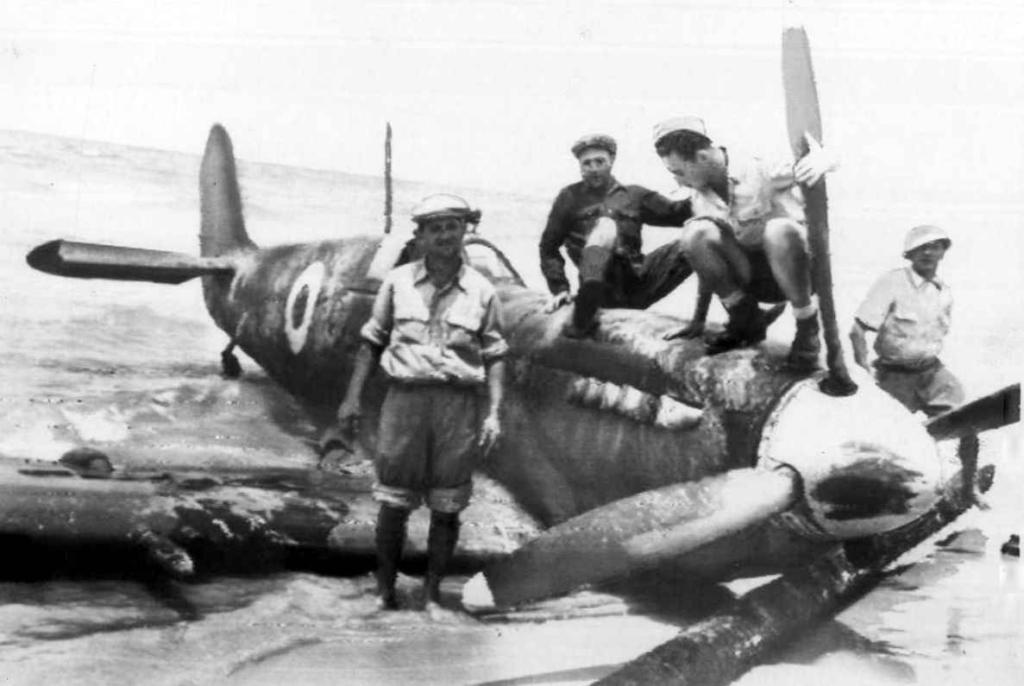
A handful of volunteer pilots against 40,000,000 Arabs!!!

Slide 13
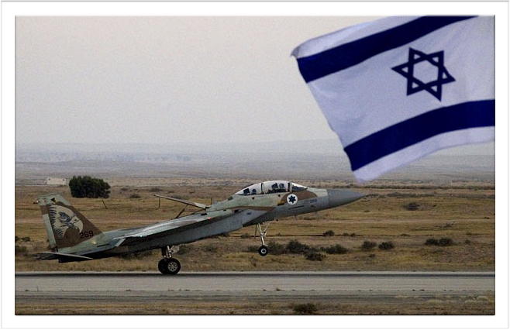
They will be a great nation

Slide 14
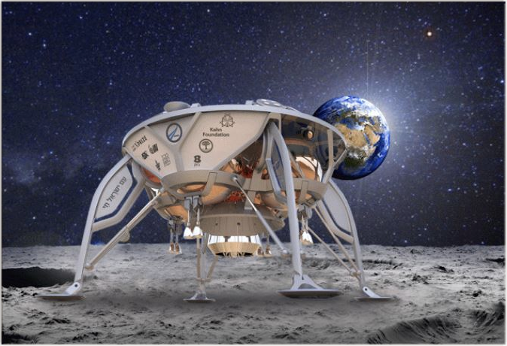

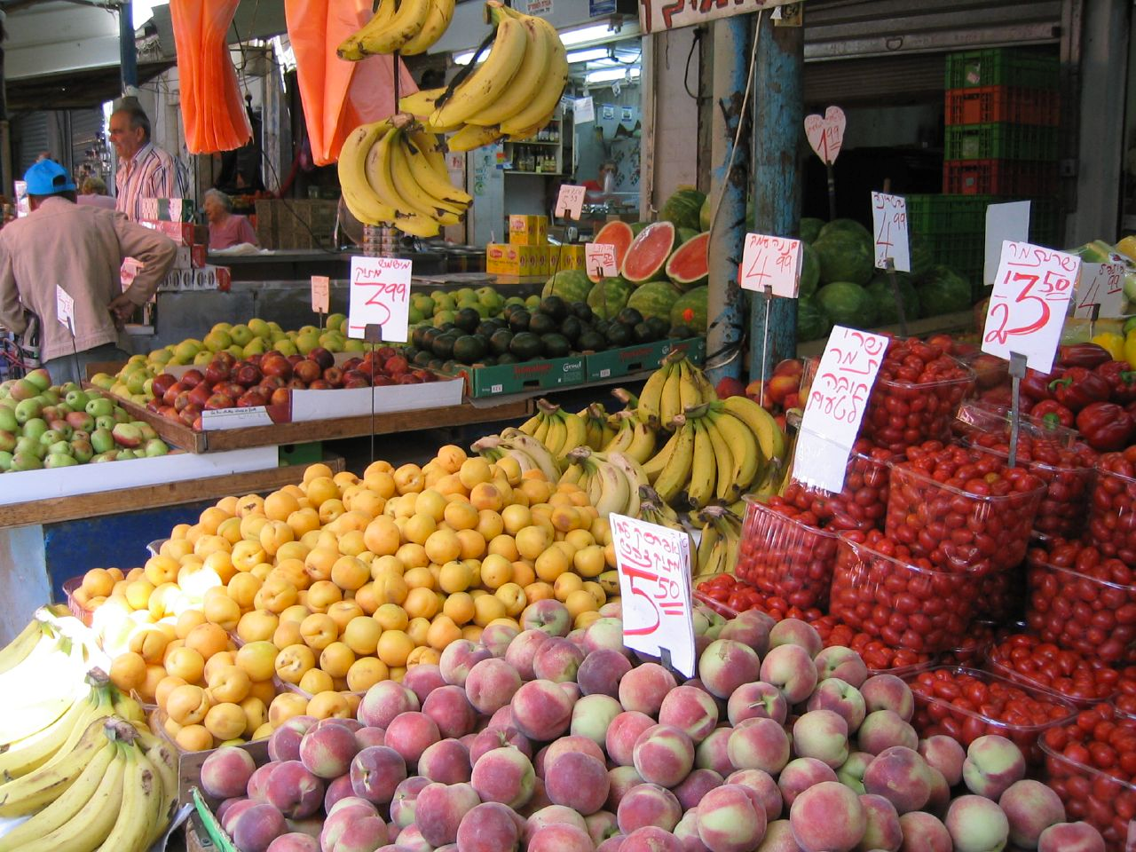
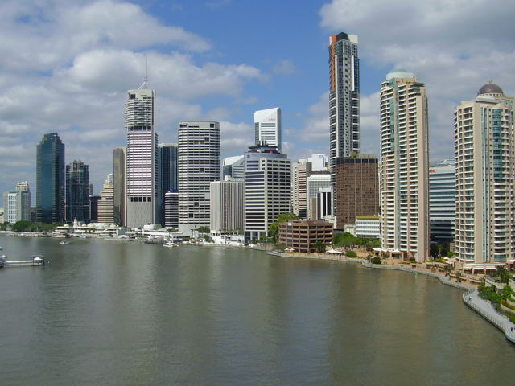
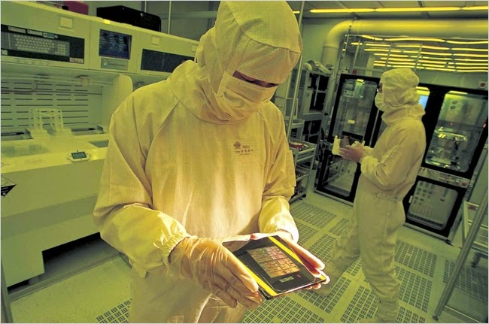
They will be prosperous

Slide 15
A final thought
If the Bible’s prophecies of Jesus, Israel and the world are true, why don’t we all take it more seriously?
“For everything that was written in the past was written to teach us, so that through endurance and the encouragement of the Scriptures we might have hope.” (Romans 15:4)

